Slide 1
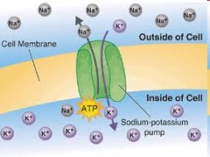
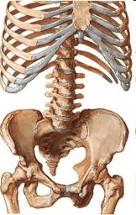
Bio Inorganic chemistry
Study of Inorganic elements in the living systems
Sodium potassium pump
(1/5th of all the ATP used)
Hemoglobin Vit B12 Hemocyanin Carbonic anhydrase
Myoglobin Carboxypeptidase
Cytochromes
Ferredoxin

Slide 2
Important roles metals play in biochemistry
1. Regulatory Action Sodium potassium channels and pump
Na, K Nerve signals and impulses, action potential muscle contraction
2. Structural Role Calcium in bones, teeth
Ca, Mg provide strength and rigidity
3. Electron transfer agents Cytochromes: redox intermediates
Fe²⁺/Fe³⁺ membrane-bound proteins that contain heme groups and carry out electron transport in Oxidative phosphorylation
4. Metalloenzymes Carbonic anhydrase, Carboxypeptidase
Zn biocatalysts, CO₂ to HCO₃⁻, protein digestion
5. Oxygen carriers and storage Hemoglobin, Myoglobin, Hemocyanin
Fe, Cu 18 times more energy from glucose in presence of O₂
6. Metallo coenzymes Vitamin B 12
Co biomethylation

Slide 3
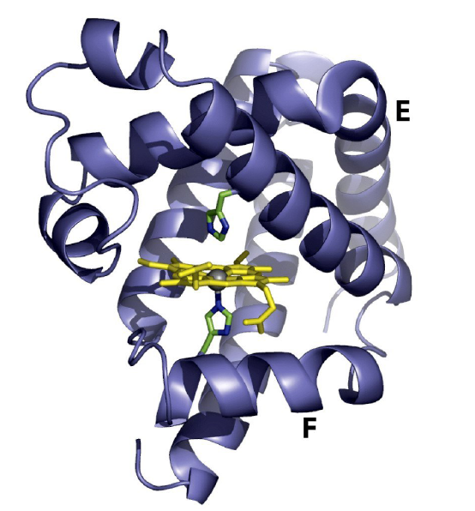
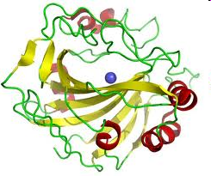
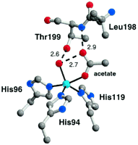
Structure of a metallo-protein : A metal complex perspective
Spiral - α helix form of protein Tape - β Pleated sheet form of protein
Prosthetic groups – A metal complex positioned in a crevice. Some of the ligands for this complex or some times all of the ligands are provided by the side groups of the amino acid units.
The geometry around the metal and bond distances and angles are decided by the protein unit
Myoglobin Carbonic anhydrase

Slide 4
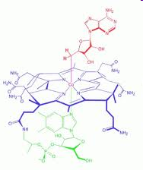
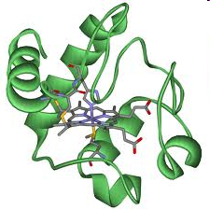
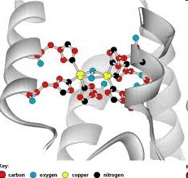
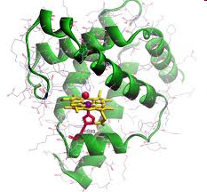
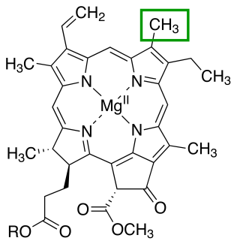
Metalloenzymes and Oxygen carriers = Protein + Cofactor
A cofactor is a non-protein chemical compound that is bound to a protein and is required for the protein's biological activity. These proteins are commonly enzymes. Cofactors are either organic or inorganic. They can also be classified depending on how tightly they bind to an enzyme, with loosely-bound or protein-free cofactors termed coenzymes and tightly-bound cofactors termed prosthetic groups.
Porphyrins with different metals at its centre are a common prosthetic group in bioinorganic chemistry
Cytochrome C
Coenzyme B12
Hemocyanin
Myoglobin
Chlorophyll

Slide 5
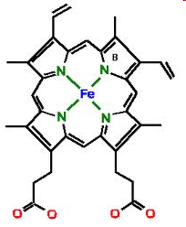
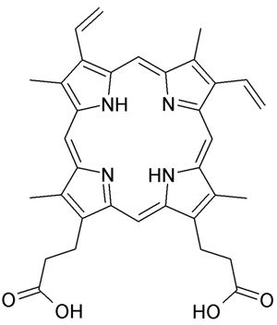
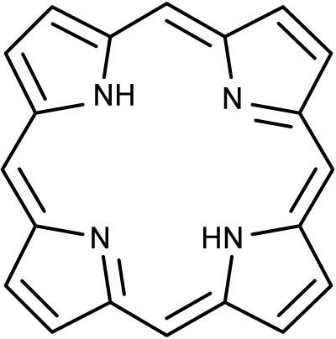
Protoporphyrin IX and Heme
15 different ways to arrange the substituents around the porphyrin. Only one isomer protopophyrin IX is found in the living system. Porphyrins are planar and aromatic

Slide 6
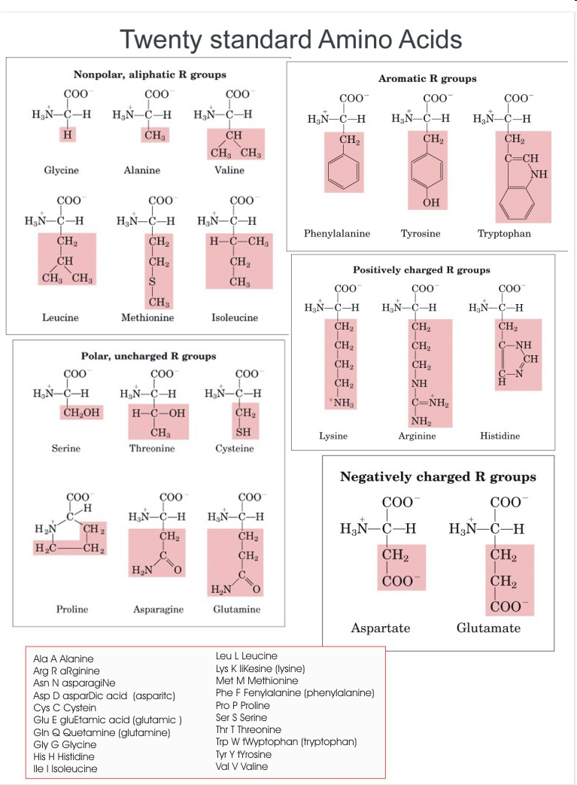
Proteins –consists of different amino acids in a specific sequence connected by the peptide bond –

Slide 7
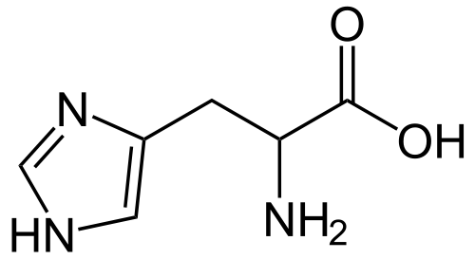
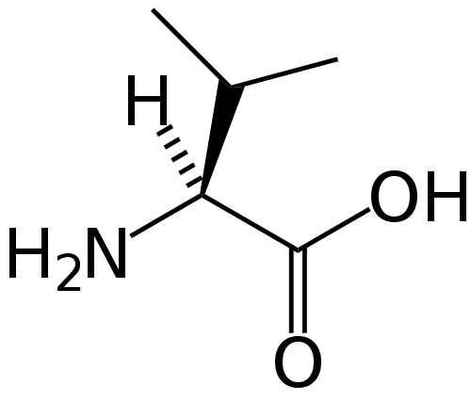
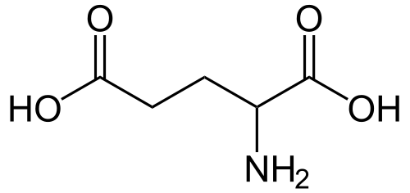
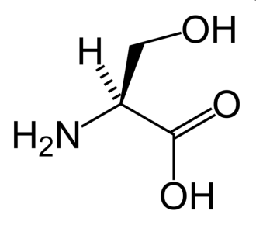
A few important amino acids relevant to the present course
HISTDINE This amino acid has a pKa of 6.5. This means that, at physiologically relevant pH values, relatively small shifts in pH will change its average charge. Below a pH of 6, the imidazole ring is mostly protonated.
VALINE is a branched-chain amino acid having a hydrophobic isopropyl R group. In sickle-cell disease, valine substitutes for the hydrophilic amino acid glutamic acid in hemoglobin.Valine is hydrophobic
GLUTAMIC ACID has carboxylic acid functional group which is hydrophilic, has pKa of 4.1 and exists in its negatively charged deprotonated carboxylate form at physiological pH ranging from 7.35 to 7.45.
SERINE Serine is an amino acid having a CH₂OH side group. By virtue of the hydroxyl group, serine is classified as a polar amino acid. Serine was first obtained from silk protein, a particularly rich source, in 1865.

Slide 8
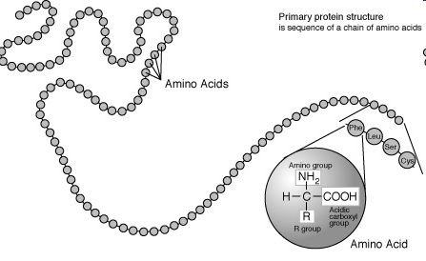
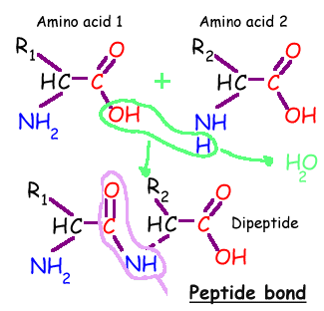
The primary structure of a protein

Slide 9
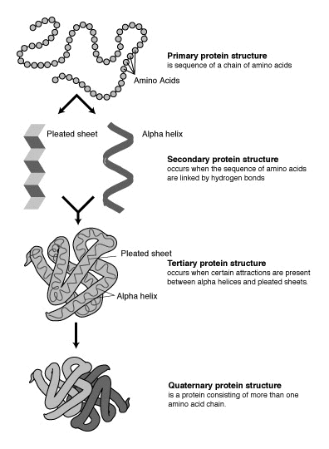
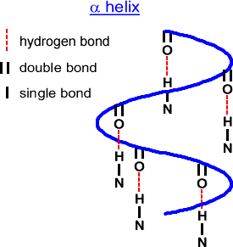
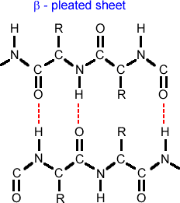
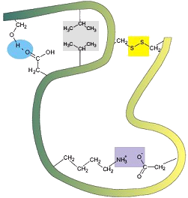
The four levels of protein structure
H bond between side chains, hydrophobic interactions, disulfur linkages, electrostatic interactions
See youtube video “protein structure” Univ of Surrey ’

Slide 10
Hemoglobin- a quaternary structure of a protein
4 units
Each unit has a prosthetic group (heme) embedded in a crevice and partly coordinated by histidine units

Slide 11
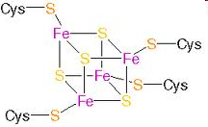
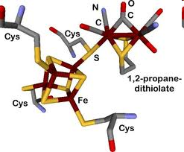
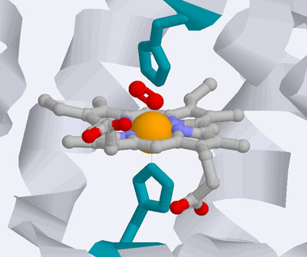
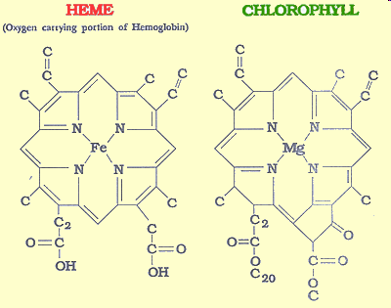
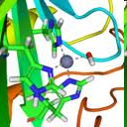
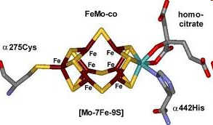
Inorganic Active site / Prosthetic group
In molecular biology the active site (prosthetic group) is part of an enzyme where substrates bind and undergo a chemical reaction. It can perform its function only when it is associated with the protein unit
Ferredoxin (e transfer)
Heme in Myoglobin (O₂ storage)
Carbonic anhydrase Enzyme)
Nitrogen Fixation

Slide 12
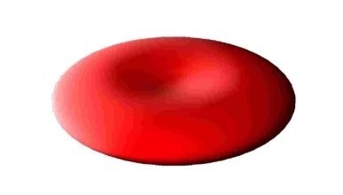
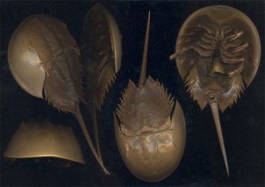
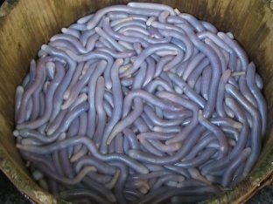
Inorganic Prosthetic group of three well known oxygen carriers
Present in Vertebrates
Present in molluscs
Present in some sea worms

Slide 13
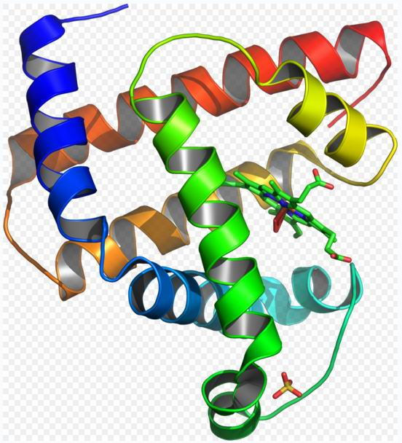
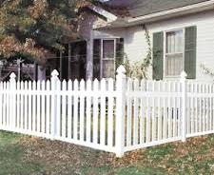
Can the prosthetic unit part of a metalloprotein perform its normal function without the protein unit around it ?
Reversible binding of O₂ is possible on when protein unit is present around the heme unit

Slide 14
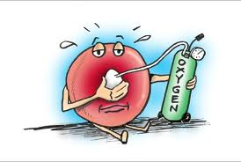
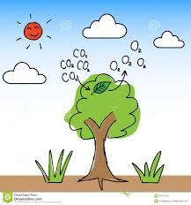
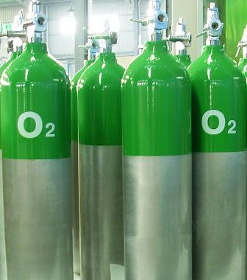
Oxygen : A few Questions
Why do we need oxygen or why do we breathe?
What happens to oxygen in our body and where does it happen?
What does this reaction produce and how?
How exactly is oxygen carried around and stored in the body?
How exactly is CO₂ removed from the body?

Slide 15
Electron transfer agents Cytochromes: redox intermediates
Fe²⁺/Fe³⁺ membrane-bound proteins that contain heme groups and carry out electron transport in Oxidative phosphorylation
Cytochromes are, in general, membrane-bound (i.e. inner mitochondrial membrane) heme proteins containing heme groups and are primarily responsible for the generation of ATP via electron transport.
They are found bound on the inner mitochondrial membrane either as monomeric proteins (e.g., cytochrome c) or as subunits of bigger enzymatic complexes that catalyze redox reactions. These heme proteins are classified on the basis of the position of their lowest energy absorption band in the reduced state, as cytochromes a (605 nm), b (~565 nm), and c (550 nm).

Slide 16
Electron transfer agents; e.g. Cytochrome C

Slide 17
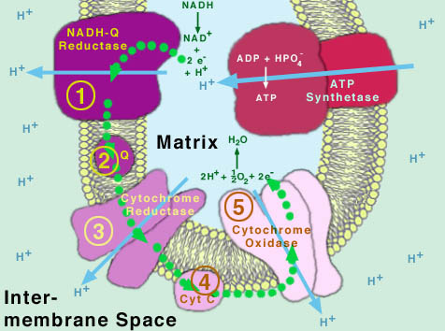
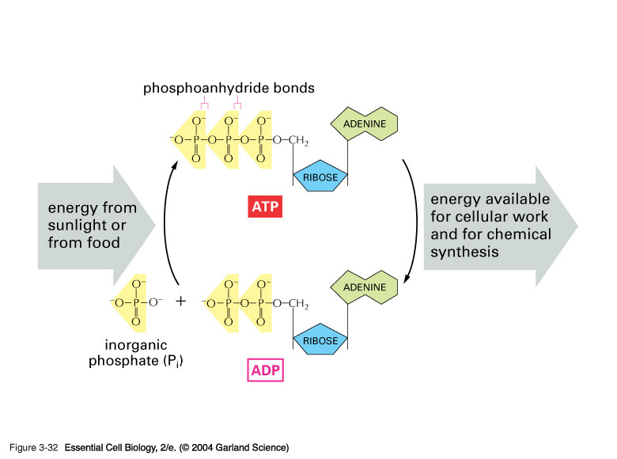
Glycolysis + Oxidative phosphorylation: How food is converted into energy
ATP : Universal currency for energy
in living systems
Different forms of Cytochromes (except Cytochrome P-450) are involved in the electron transfer process leading to ATP synthesis and conversion of O₂ to H₂O
See youtube video ‘cellular respiration ( electron transfer chain)’

Slide 18
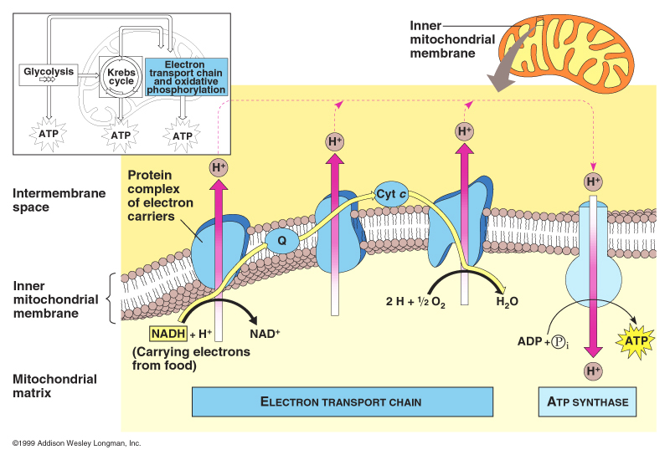

Slide 19
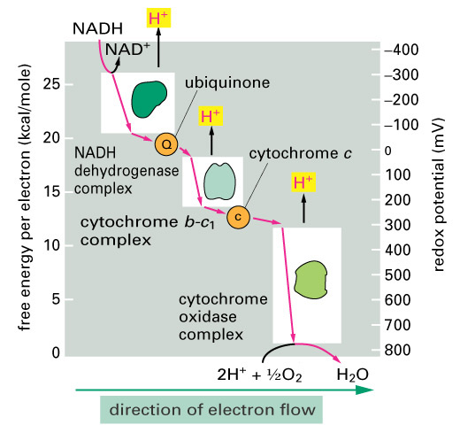
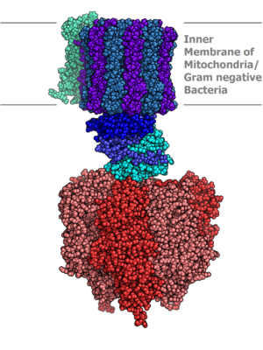
Actual structure of ATP synthase unit (a molecular machine!)
Cytochromes a and a₃ | Cytochrome c oxidase with electrons delivered to complex by soluble cytochrome c (hence the name)
Cytochromes b and c₁ | Cytochrome c reductase

Slide 20
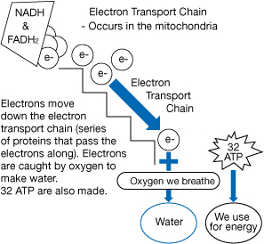
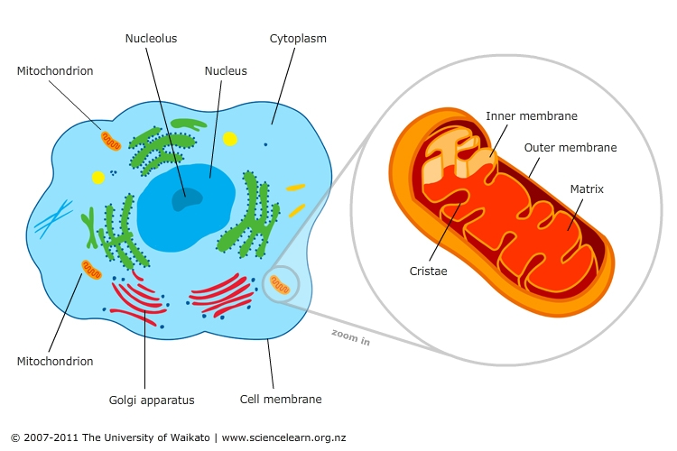
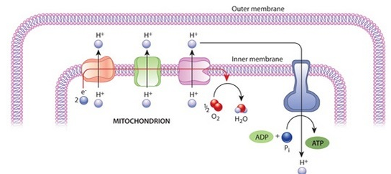

Slide 21
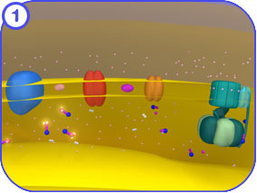
Why do we need oxygen or why do we breathe?
Oxygen is required for efficiently converting glucose to energy and generate ATP (Oxidative phosphorylation). In the presence of oxygen 18 times more energy is released from the oxidation of glucose
What happens to oxygen in our body and where does it happen?
Oxygen gets converted to water. It happens on the inner membrane of the mitochondrion exactly at the last stage of electron transport chain (on cytochorme c oxidase)
How exactly does oxygen change to water ?
Protons present inside the mitochondrion along with the electrons of the correct potential ( generated during oxidation of food and supplied through the electron transport chain) react with O₂ and convert it to water generating a proton gradient
What does this reaction result in?
The proton gradient generated during the electron transport chain and conversion of O₂ to water drives the molecular machine called ATP synthase which makes ATP from ADP and P_{i} (Inorganic phosphate). ATP is the universal currency of energy in living systems
How exactly is oxygen carried around and stored in the body?
Su…gar goes to ATP…. !
Youtube: ATP synthase molecular machines

Slide 22
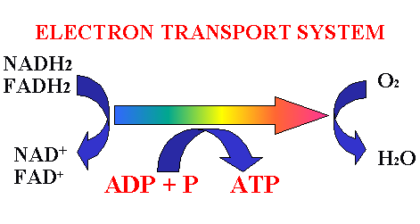
Cytochromes in the electron transport chain
Cytochrome reductase (or b): Complex unit having 2 different hexacoordinated hemes and an Fe-S cluster
Function :electron transfer and proton gradient generation
Cytochrome c: Unit having one hexacoordinated heme
Function: electron transfer
Cytochrome c oxidase: Unit has pentacoordinated heme and tricoordinated Cu
Function: electron transfer to O₂ converting it to water
+ proton gradient generation
Ageing is related to generation of oxygen based free radicals which degrade mitochondrial membranes

Slide 23
Redox intermediates in electron transfer
Cytochrome C
Protein chain has 103 amino acid units in some fish, 104 units in terrestrial vertebrates and 112 in plants
The most structurally well understood cytochrome. The heme active site is hexa coordinated with N from a histidine residue and S from a methionine residue. Present in photosynthesis and respiration chains- one of the oldest chemicals present in biological processes

Slide 24
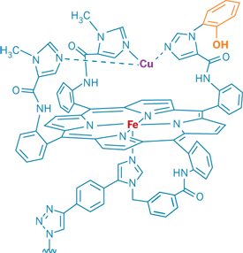

Active site of Cytochrome c oxidase
The last enzyme in the respiratory electron transport chain and is located in the mitochondrial membrane. It receives an electron from each of four cytochrome c molecules, and transfers them to one oxygen molecule, converting molecular oxygen to two molecules of water.
The Fe is pentacoordinated and binds O₂ (along with the Cu) before reducing it.
This is also the site which CN⁻ binds during cyanide poisoning [stabilizing the Fe³⁺ state and preventing its redox (Fe²⁺/ Fe³⁺) activity] (Cyanide is a very strong ligand)
Youtube video: A metabolic poison How cyanide disrupts ATP synthesis
Cyanide
Summary reaction:
4 Fe ²⁺cytochrome + 8 H⁺_{in} + O₂ → 4 Fe ³⁺cytochrome + 2 H₂O + 4 H⁺_{out}

Slide 25
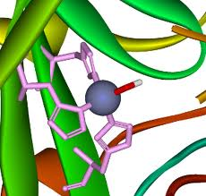
Metalloenzymes: Carbonic Anhydrase
A single polypeptide chain ( M = 29,000) complexed to one Zn²⁺ ion. The zinc prosthetic group in the enzyme is coordinated in three positions by histidine side-chains. The fourth coordination position is occupied by water. This causes polarisation of the hydrogen-oxygen bond, making the oxygen slightly more negative, thereby weakening the bond. A fourth histidine is placed close to the substrate of water and accepts a proton. This leaves a hydroxide attached to the zinc. The reaction catalyzed by carbonic anhydrase is given below which occurs 5000 times faster in presence of the enzyme:
in tissues- high CO₂ concentration)
Carbonic anhydrase has one of the highest overall rates of reactions of any enzymes. This is expressed in terms of turnover number of a catalyst (number of substrate molecules converted per molecule of the enzyme per second; same as TOF in organometallic catalysis). For human carbonic anhydrase it is 400,000 to 600,000 per second.
Most efficient catalytic reaction known so far !!
Reaction increases acidity in the tissues

Slide 26




Metalloenzymes: Carbonic Anhydrase
Why Zinc?
A good Lewis Acid
Only one stable oxidation state
Complexes are labile than other divalent metals
Favors tetrahedral geometry

Slide 27

The active site also contains specificity pocket for carbon dioxide, bringing it close to the hydroxide group. This allows the electron rich hydroxide to attack the carbon dioxide, forming bicarbonate
Carbonic anhydrase increases acidity in the vicinity..With enough carbonic anhydrase enzymes present, therefore, carbon dioxide can cause a decrease in the pH of the solution due to all the protons produced from its reaction with water.
Watch Youtube video carboanhydrase

Slide 28


Dioxygen storage in the tissues: Myoglobin
Proximal histidine
Eight α helixes (~75%),
M. Wt. ~17,000
153 amino acid units Single heme unit pentacoordinated (deoxy)
Distal histidine

Slide 29
Changes at the active site during oxygenation of Myoglobin
Role of distal histidine: Makes O₂ to bind in a bent fashion and makes it difficult for CO to bind in a linear fashion.
An isolated heme binds CO 25000 times as strongly as O₂ in solution. In the living system binding affinity for oxygen is reduced considerably. For CO to bind strongly, it has to bind linearly which is made difficult by distal histidine

Slide 30
Oxymyoglobin and oxyhemoglobin: Evidence for Fe³⁺ O₂−
ν _{O-O} of oxyhemoglobin, 1107 cm⁻¹
is closer to the
ν _{O-O} O₂⁻ value of 1145 cm⁻¹ than
ν _{O-O} O₂ value of 1550 cm⁻¹
This difference suggests the formation of O₂⁻ which is a spin ½ ion in combination with low spin Fe³⁺ which is also spin ½ and these two spins can pair by what is well known as antiferromagnetic coupling and will be diamagnetic

Slide 31
Basics of oxygenation remains same for Hb and Mb. But there are some differences in the way the four units get oxygenated. This begins with pulling of the proximal histidine when Fe gets inside the plane of the porphyrin ring upon oxygen binding

Slide 32

The Bohr Effect
Christian Bohr, father of Niels Bohr discovered this effect. An increase in concentration of protons and/or carbon dioxide will reduce the oxygen affinity of hemoglobin
The chemical basis for the Bohr effect is due to the formation of two salt bridges of the quaternary structure. One of the salt bridges is formed by the interaction between Histidine 146 and Lysine 40. This connection will help to orient the histidine residue to also interact in another salt bridge formation with the negatively charged aspartate 94. The second bridge is formed with the aid of an additional proton on the histidine residue.
Below a pH of 6, the imidazole ring of histidine is mostly protonated thus favoring salt bridge formation
A salt bridge ( weak electrostatic interaction)

Slide 33


Hemoglobin; An allosteric protein
An allosteric protein does not have fixed properties. Its functional characteristics of are regulated by specific molecule present in its environment. Hemoglobin is an allosteric protein while Myoglobin is not.
Function of Hemoglobin in the living system is regulated by oxygen partial pressure, H+ concentration and 2, 3 biphosphoglycerate presence (BPG)
O₂
Bohr Effect (effect of H+ on Hb)
2,3-BPG (saturation of O2 on Hb-F)

